Slide 1
Enhancing LAMMPS Capabilities
Granular Models, Coding Concepts, CAD Interoperability
and Coupling to Continuum Methods
2nd LAMMPS Workshop, Albuquerque, Aug 2011
Christoph Kloss*, Christoph Goniva**, Stefan Amberger, Alice Hager, Andreas Aigner, Michael Friedl, Stefan Pirker***
*christoph.kloss@jku.at, ** christoph.goniva@jku.at, ***stefan.pirker@jku.at
all CD Laboratory on Particulate Flow Modelling Johannes Kepler University Linz, Austria
www.liggghts.com | www.cfdem.com | www.particulate-flow.at

Slide 2
Outline

Slide 3
Open Source DEM and CFD-DEM Outline
Introduction
Our Group, Mission Statement
Models
Granular Contact Models, Heat Transfer, SPH, Multisphere Model
CAD Interoperability
Mesh Import, Particle Insertion, Mesh regions, Wear Prediction
Features and Coding Concepts
Load Balancing, Per-Particle Properties, Transport Equations
Coupling to Continuum Methods
OpenFOAM®, Resolved and Unresolved CFD-DEM, Multiphysics
Christian Doppler Laboratory on Particulate Flow Modelling www.particulate-flow.at
3

Slide 4
I. Introduction
About Us / Mission Statement

Slide 5
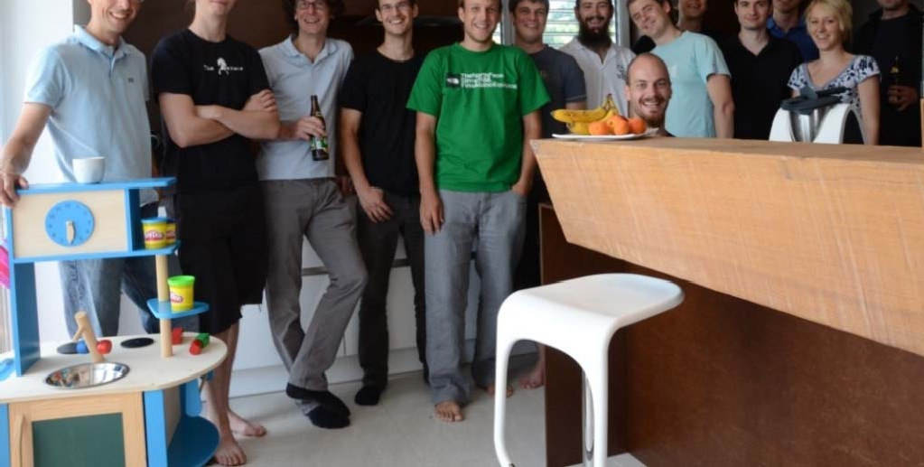
About Us
Mission Statement
CD Lab Particulate Flow Modelling (head: Stefan Pirker)
6 Post-Docs, 7 PhD students, 5 master students
Goal: Particulate Flow Modelling...
Research focus:
Fluid flow € CFD, LB, SPH
Granular flow € CFD, DEM/MD
Heat transfer
Experimental Validation
...of industrially relevant processes
Application examples include:
Blast furnaces, cyclones, pneumatic conveying, fluidized beds, dryers, wet scrubbers, conveyor and chute systems, tablet pressing, powder sintering, hopper flow,
soil sampling, energy storage, river bed erosion, blood flows...
www.particulate-flow.at
5

Slide 6
The LIGGGHTS/CFDEM Codes Overview
LIGGGHTS = An Open Source, C++, MPI parallel DEM code
LAMMPS IMPROVED FOR GENERAL GRANULAR AND GRANULAR HEAT TRANSFER SIMULATIONS
CFDEM = Coupling of LIGGGHTS to CFD code OpenFOAM®
CFD-DEM
WWW.LIGGGHTS.COM | WWW.CFDEM.COM
The web platform now has about 600 registered users Published in [1, 2, 3, 4, 10, 11, 12, 13, 14, 16]
www.particulate-flow.at
5

Slide 7




















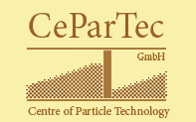






The LIGGGHTS+CFDEM Codes
Cooperations
CD Lab
Further (formal and informal) cooperations for LIGGGHTS and CFDEM
www.particulate-flow.at
5

Slide 8

The LIGGGHTS Code Relation to LAMMPS
present
LIGGGHTS
2.0
???
LIGGGHTS
1.0
18.04.2010
...
LIGGGHTS
1.3.1
15.06.2011
LIGGGHTS
beta 1
19. Feb. 2010
Currently ~30.000
lines of code (LOC)
LAMMPS 24-Jan-2010
LAMMPS 30-Mar-2010
LAMMPS 15-Jun-2011
....
Sandia National Labs, Albuquerque, US
+ community contributions
www.particulate-flow.at
5

Slide 9
II. Models

Slide 10
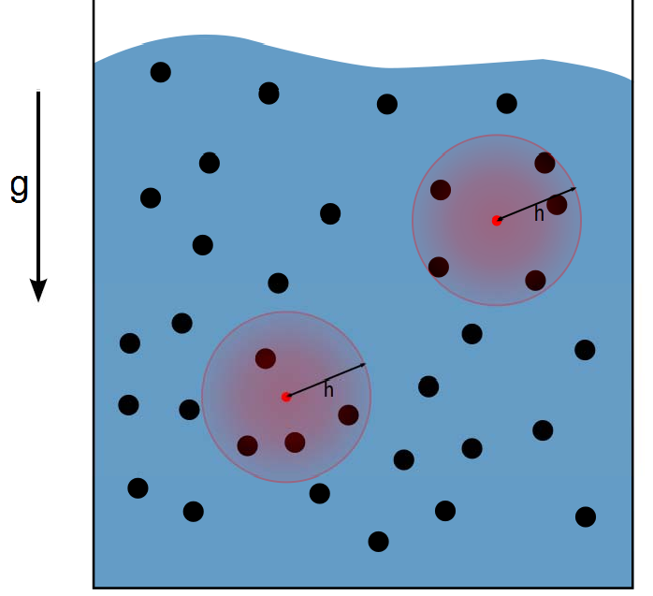
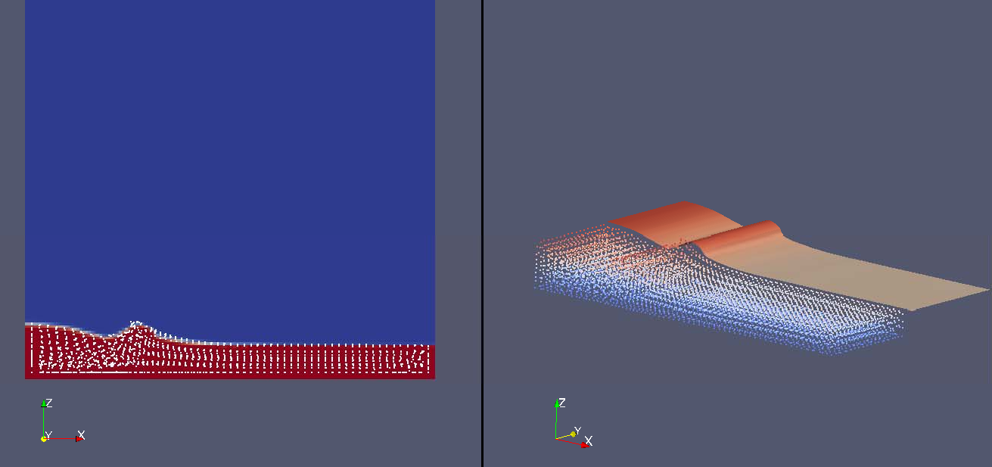
LIGGGHTS Models - Released
SPH – Smoothed Particle Hydrodynamics
SPH is well-suited for geometrically complex systems, and cases where numerical diffusion of Finite Volume approach is not acceptable
Released in LIGGGHTS 1.4 – commands pair sph, fix sph/density/continuity, fix sph/density/corr, fix sph/pressure/summation, fix wall/sph, fix wall/region/sph
Principle of SPH
Sloshing Tank with SPH in LIGGGHTS vs.
Volume of Fluid (VOF) Method in OpenFOAM®
www.particulate-flow.at

Slide 11
LIGGGHTS Models - Released
Hertz-Mindlin (HM) Granular Contact Model
F = ( k_{n} δn_{ij} − γ _{n} ) + ( k_{t} δ t_{ij} − γ _{t}
vn_{ij}
vt_{ij} )
{
normal normal
tangential tangential
₁₄₄ove₄rla₄p ₂₄r₄ela₄tive₄ve₃l .
₁₄o₄ver₄lap₄₂₄re₄lati₄ve v₄e₃l .
normal force
tangential force
4
_{Y}*
S_{n} = 2Y* R* δ _{n} ,
S_{t} = 8G*
R* δ _{n}
2 ₎
k_{n} =
R* δ _{n} ,
₌ (1−ν₁ ) (
3
ln( e ) , 1
2
₊ 1−ν ₂
β =
_{Y}*
,
5 _{β}
ln ( e ) + π
Y
Y
2 2
1
2
γ = −2
S m* ≥ 0,
1 ₌ 2 (2 + ₁ )(1− ₁ ) ₊ 2 (2 +
₂ )(1− ₂ )
n
6
n
_{G}*
Y
Y
k_{t} = 8G* R* δ ,
1
2
n
1 ₌ 1 ₊ 1 1 1 1
5
6
_{R}*
, _{m*} = +
γ _{t} = −2
β S_{t} m* ≥ 0.
R R m m
1 2 1 2
Y...Young's modulus
...Poisson ratio
G...Shear modulus e...coeff.of restitution
www.particulate-flow.at

Slide 12
LIGGGHTS Models - Released Hertz-Mindlin (HM) Contact Model
F = ( k_{n} δn_{ij} − γ _{n} ) + ( k_{t} δ t_{ij} − γ _{t}
vn_{ij}
vt_{ij} )
{
normal normal
tangential tangential
₁₄₄ove₄rla₄p ₂₄r₄ela₄tive₄ve₃l .
₁₄o₄ver₄lap₄₂₄re₄lati₄ve v₄e₃l .
normal force
tangential force
4
_{Y}*
S_{n} = 2Y* R* δ _{n} ,
S_{t} = 8G*
R* δ _{n}
2 ₎
k_{n} =
R* δ _{n} ,
₌ (1−ν₁ ) (
3
ln( e ) , 1
2
₊ 1−ν ₂
β =
_{Y}*
,
5 _{β}
ln ( e ) + π
Y
Y
2 2
1
2
γ = −2
S m* ≥ 0,
1 ₌ 2 (2 + ₁ )(1− ₁ ) ₊ 2 (2 +
₂ )(1− ₂ )
n
6
n
_{G}*
Y
Y
k_{t} = 8G* R* δ ,
1
2
n
1 ₌ 1 ₊ 1 1 1 1
5
6
_{R}*
, _{m*} = +
γ _{t} = −2
β S_{t} m* ≥ 0.
R R m m
1 2 1 2
Y...Young's modulus
...Poisson ratio
G...Shear modulus e...coeff.of restitution
www.particulate-flow.at

Slide 13
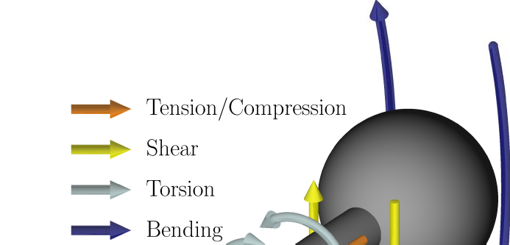
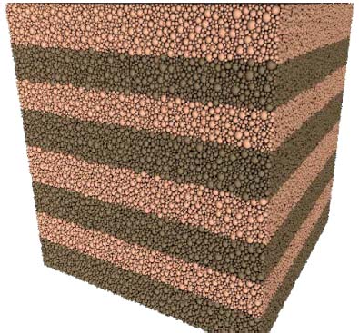
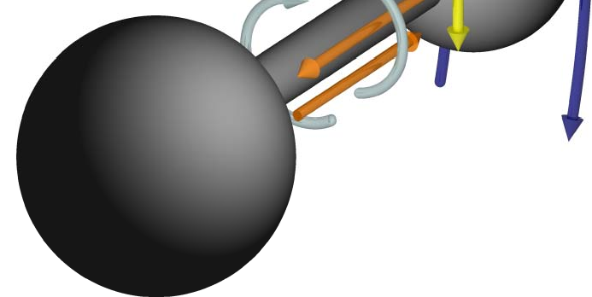
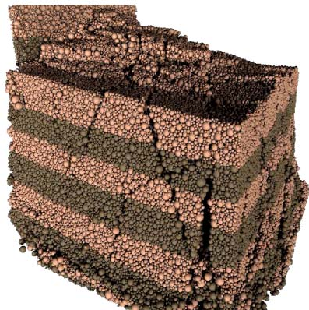
LIGGGHTS Models – Unreleased Particle Bonds
Particle bonds are inter-particle connections able to resist
tension/compression,
shear,
torsion and
bending
up to a certain breakage limit. Once broken, the bond connection is lost permanently. Particle bonds and related models can be used to
model soils, „glued particles“, particle breakage, crack formation in beams („lattice beam model“) etc...
Looking for co-workers to make model ready for release!
Asaf et. al, Soil & Tillage Research 92 (2007) 227–242 “Determination of discrete element model parameters required for soil tillage” Shmulevich: Soil & Tillage Research 111 (2010) 41–53 “State of the art modeling of soil–tillage interaction using discrete element method” Zhang, Li: Journal of Terramechanics 43 (2006) 303–316 “Simulation on mechanical behavior of cohesive soil by Distinct Element Method”,
Pics from: Latham, S, Weatherly, D.,: Scripting Parallel Discrete Element Simulations with ESyS_Particle, https://twiki.esscc.uq.edu.au/bin/view/ESSCC/ESySParticleDownload
www.particulate-flow.at

Slide 14
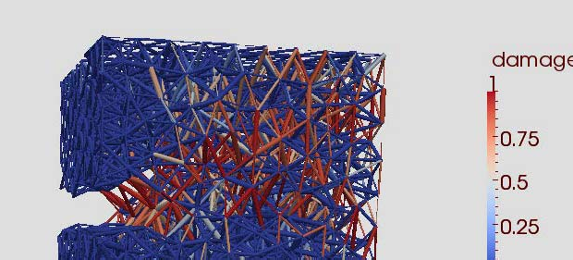


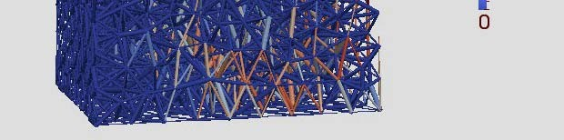

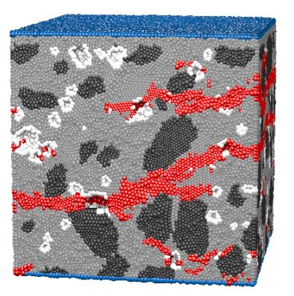
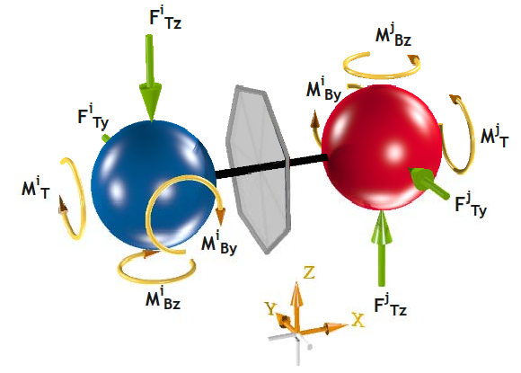
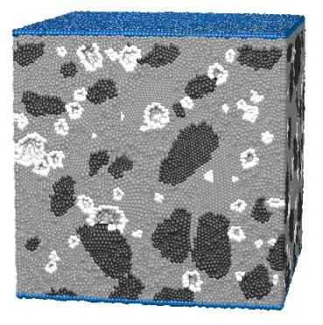
Lattice Beam Model
Dynamic fracture roughness in a concrete microstructure
LIGGGHTS will incorporate a beam lattice model (e.g. *,**) used to study fracture and fragmentation phenomena.
* G. Lilliu, J.G.M. van Mier, 3D lattice type fracture model for concrete, Engrg. Fract. Mech. 70 (2003) 927–941.
**J.G.M. van Mier, E. Schlangen, A. Vervuurt, Lattice type
fracture models for concrete, in: H.B. Mühlhaus (Ed.), Continuum Models for Materials with Microstructure, John Wiley & Sons, 1995, pp. 341–377.
Jean-Francois Jerier EPF Lausanne Computational Solid Mechanics
Numerical concrete sample based on a X-ray micro- tomography image (25mm³)
The crack paths (red) crossing the sample
Timoshenko beam theory leads to the interaction between the spheres
500.000 polydisperse spheres and 4 million beams represent this sample Each simulation calculated on 60 processors in 3 days
Christian Doppler Laboratory on Particulate Flow Modelling www.particulate-flow.at

Slide 15
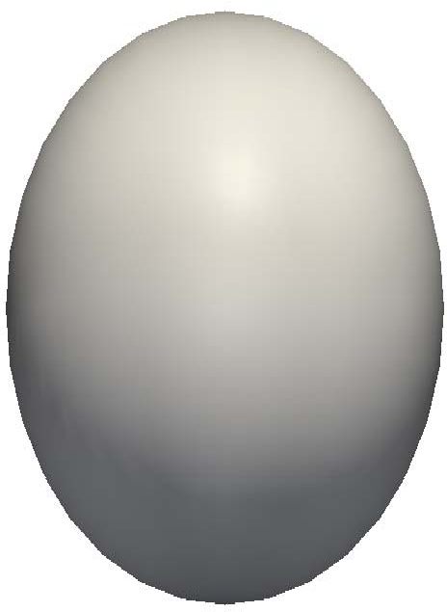
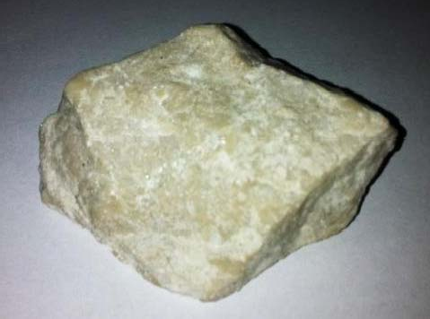
LIGGGHTS Models Capturing non-sphericity
Granular particles outside laboratories are rarely spherical
≠
www.particulate-flow.at

Slide 16
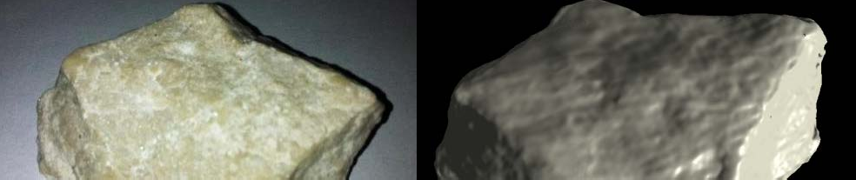
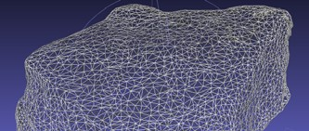


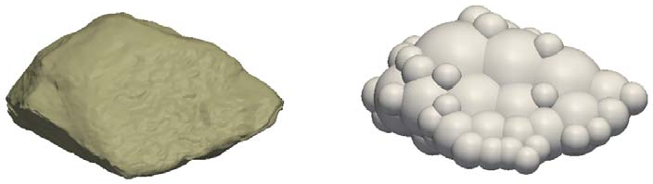
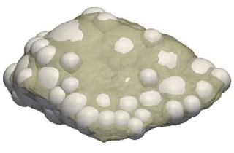
LIGGGHTS Models Capturing non-sphericity
Multi-Sphere Approach
Step 1 – Particle Image by Laser Scanner
Step 2 – Generate Multi-Sphere Simulation Model
www.particulate-flow.at

Slide 17
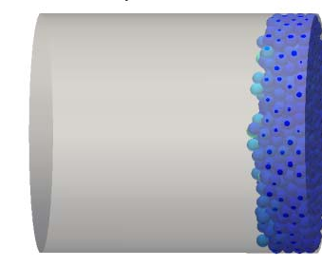
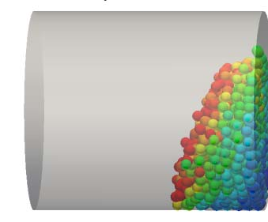
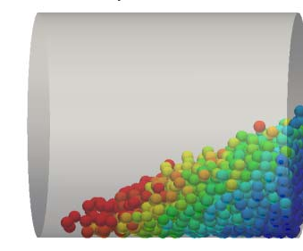
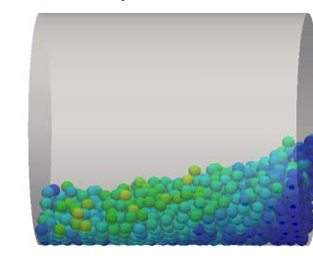
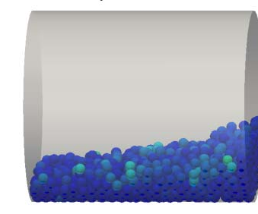
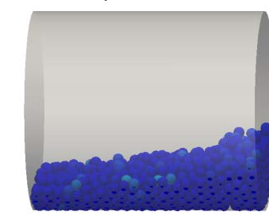
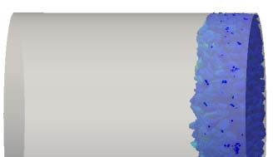
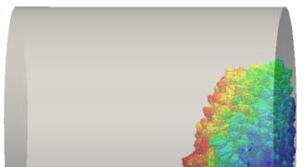
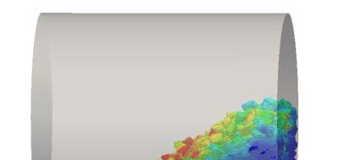
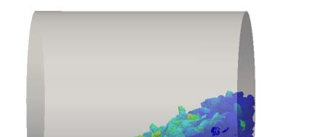
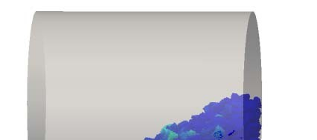
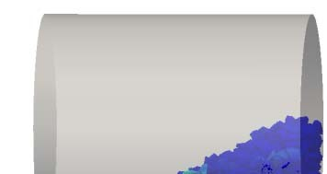
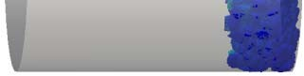
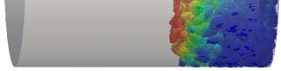
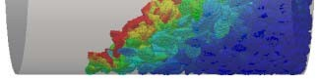
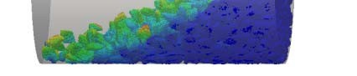
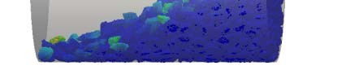
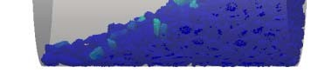
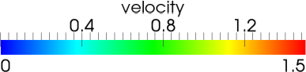
LIGGGHTS Models Capturing non-sphericity
Step 3 – LIGGGHTS Simulation
Show case cylinder: Gravity tilted so that angle of repose forms
Spherical
Non-Spherical
www.particulate-flow.at

Slide 18
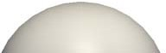
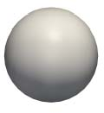
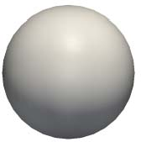

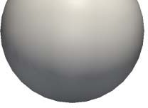
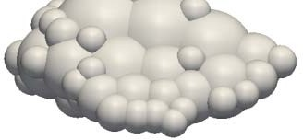
LIGGGHTS Models Capturing non-uniformity
In reality, no particle is like any other...
Fix particledistribution/discrete takes particletemplates as input and serves as input for insertion commands
Fix particletemplate/sphere and fix particletamplate/multisphere
fix particledistribution/discrete FixParticletemplate **list;
list[0]
list[1]
list[2]
fix particletemplate/sphere
fix particletemplate/sphere
fix particletemplate/multisphere
-
50 mass%
uniform size distribution
35 mass%
ρ = 2000 kg/m³
15 mass%
ρ = 1500 kg/m³
ρ = 3500 kg/m³
www.particulate-flow.at

Slide 19
III. CAD Interoperability

Slide 20
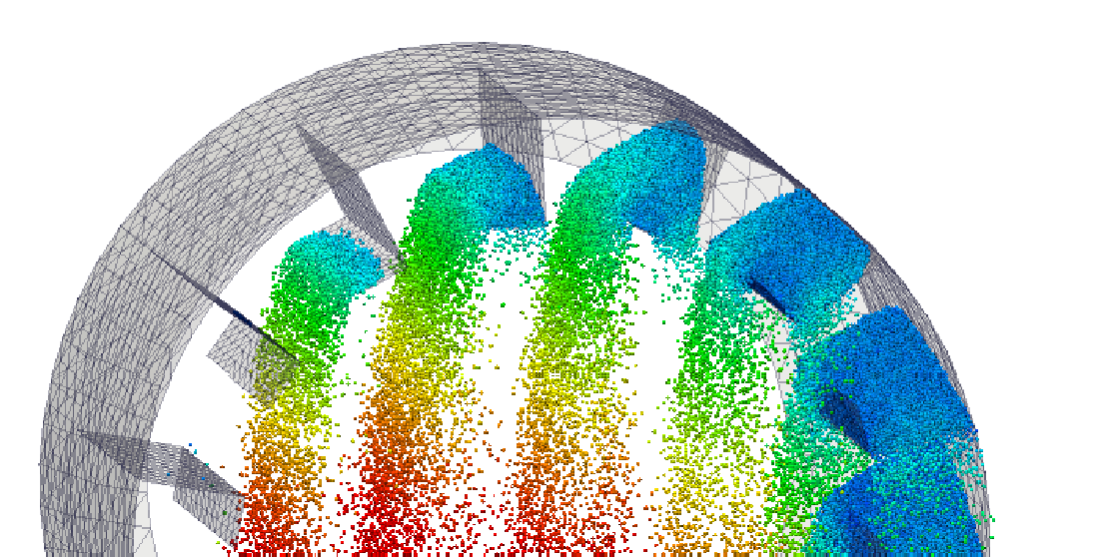
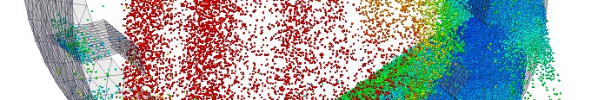
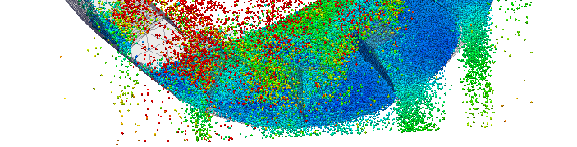

CAD Interoperability Importing a Mesh
Industrial scale granular problems need CAD/Mesh interface!
Rotary dryer, ~1M particles
Work with Diego Peinado (Intrame Madrid)
Command fix mesh/gran reads a triangular mesh from STL or VTK
Command fix move/mesh/gran translates/rotates etc the mesh (like fix move)
www.particulate-flow.at

Slide 21
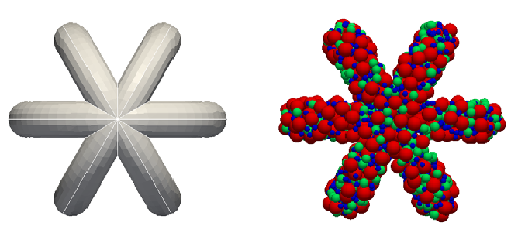
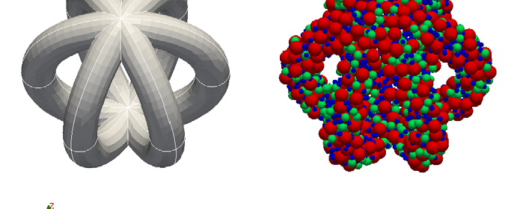
CAD Interoperability
Generating a Non-trivial Particle Packing
Packing in tetrahedral mesh
Command region tetmesh Reads tet mesh from VTK to be used as a region
Command fix insert/pack Works similar to fix pour Can use arbitrary regions (also region tetmesh)
www.particulate-flow.at

Slide 22
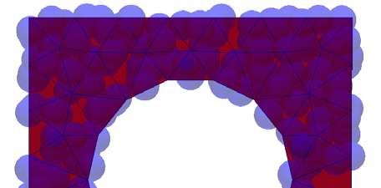
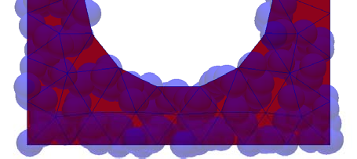



CAD Interoperability Generating a Particle Stream
Particle insertion at surface
Command fix insert/stream Extrudes triangular surface mesh
Particles are inserted in packages like with fix pour and are integrated by the fix with constant vel until they reach the surface mesh. BCs are enforced at the surface mesh.
velocity
www.particulate-flow.at

Slide 23











Industrial Application
Wear Prediction at Transfer Chute
Work with Andre Katterfeld (Univ. Magdeburg, Cepartec)
Goniva, C, Katterfeld, A, Kloss, C: „Simulation of dust emission and transport and chute wear“ Proc. of 16. Fachtagung Schüttgutfördertechnik Magdeburg, Sept 2011
Wear prediction (Finnie model) Fix mesh/gran/stressanalysis
25 k particles, 4 processors: 10 sec real time (200k steps) LB on: 1146 sec CPU time LB off: 1514 sec CPU time
www.particulate-flow.at

Slide 24
IV. Features and Coding Concepts

Slide 25




Dynamic Load-Balancing What is Load-Balancing
How to distribute load between processors?
Without dynamic load balancing:
Process 0
With dynamic load balancing:
Process 0
Process 1
Process 1
advancing simulation time
advancing simulation time
www.particulate-flow.at

Slide 26







Dynamic Load-Balancing Silo Test Case
Strategy: “Simple” LB based on number of owned atoms
LB off LB on
Speed-up
www.particulate-flow.at

Slide 27
Coding Concepts
Strengths and Weak Points for LAMMPS
Strengths of coding in LAMMPS
Code easy to read and understand
Code easy to modify
Good encapsulation for many modelling tasks (fixes, computes, pair styles)
But:
Have to write lots of lo-level code (error prone), some of which is redundant
www.particulate-flow.at

Slide 28
Abstraction Layer I: Per-Particle Properties Motivation
We need a lot of different per-particle properties for our models
Temperature, heat flux, heat source (e.g. from chemical reactions)
Moisture content (water in pores), liquid surface film height
Particle Reynolds number
Drag force, Magnus force, Saffman force,... exerted by surrounding fluid
Surface dust content, dust emitted to fluid
Energy stored in elastic deformation, energy dissipated by contacts...
....
€ Need dozens of new per-particle properties for our models
www.particulate-flow.at

Slide 29
Abstraction Layer I: Per-Particle Properties Motivation
Why not store new properties in Atom class?
Error prone: Have to implement low-level code via a new AtomVec class (pack/unpack, interproc exchange, restart...)
Have to change many classes to make new property fully functional (at least Atom, AtomVec, Dump, Set, ComputePropertyAtom, FixAdapt)
This is a recurring task, so we can add an abstraction layer
Solution: Store it in a new fix property/peratom class
Implement low-level code only once
Look-up mechanism via Modify class so each other class can use it
Every model (fix) can now request to store a new per-particle property Lazy storage: only store a property if any of the models really need it
Need to touch only one class for new property
(dump, set... implemented only once for fix property/peratom)
www.particulate-flow.at

Slide 30
Abstraction Layer I: Per-Particle Properties Usage
//register dragforce if(!dragforce)
{
char* fixarg[11]; fixarg[0]="dragforce"; fixarg[1]="all"; fixarg[2]="property/peratom"; fixarg[3]="dragforce"; fixarg[4]="vector"; fixarg[5]="no";
fixarg[6]="yes";
fixarg[7]="no";
fixarg[8]="0.";
fixarg[9]="0.";
fixarg[10]="0.";
Type of fix
dragforce = modify->add_fix_property_peratom(11,fixarg);
}
www.particulate-flow.at

Slide 31
Abstraction Layer I: Per-Particle Properties Usage
//register dragforce if(!dragforce)
{
char* fixarg[11]; fixarg[0]="dragforce"; fixarg[1]="all"; fixarg[2]="property/peratom"; fixarg[3]="dragforce"; fixarg[4]="vector"; fixarg[5]="no";
fixarg[6]="yes";
fixarg[7]="no";
fixarg[8]="0.";
fixarg[9]="0.";
fixarg[10]="0.";
Name of property
dragforce = modify->add_fix_property_peratom(11,fixarg);
}
www.particulate-flow.at

Slide 32

Abstraction Layer I: Per-Particle Properties Usage
//register dragforce if(!dragforce)
{
char* fixarg[11]; fixarg[0]="dragforce"; fixarg[1]="all"; fixarg[2]="property/peratom"; fixarg[3]="dragforce"; fixarg[4]="vector";
fixarg[5]="no";
fixarg[6]="yes";
fixarg[7]="no";
fixarg[8]="0.";
fixarg[9]="0.";
fixarg[10]="0.";
Type and size of data
dragforce = modify->add_fix_property_peratom(11,fixarg);
}
www.particulate-flow.at

Slide 33

Abstraction Layer I: Per-Particle Properties Usage
//register dragforce if(!dragforce)
{
char* fixarg[11]; fixarg[0]="dragforce"; fixarg[1]="all"; fixarg[2]="property/peratom"; fixarg[3]="dragforce"; fixarg[4]="vector"; fixarg[5]="no";
fixarg[6]="yes";
fixarg[7]="no";
fixarg[8]="0.";
fixarg[9]="0.";
fixarg[10]="0.";
Settings for forward comm, reverse comm, restart
dragforce = modify->add_fix_property_peratom(11,fixarg);
}
www.particulate-flow.at

Slide 34
Abstraction Layer II: “Transport Equations” Motivation
There is another recurring task: Solving an ODE for each particle for a quantity, based on a flux and a source
E.g. solve for heat transfer, moisture, evolution of surface dust...
^{dT}p,i
•
•
m c
=
∑^{Q}pi − pj ^{+ Q}pi ,source
p p
dt
₁con₄t₄ac₂ts i₄− j₄₃
14243
heat generation due to sources,
e.g. reactions
heat conduction by contacts
(A
₎1 / 2 _{ΔT}
•
₌ ^{4 k}pi ^{k}pj
^{Q}pi − pj
contact ,i − j pi − pj
^{k}pi ^{+ k}pj
Solution: A new fix transportequation/scalar
Every model can request a scalar transport equation to be solved
The transportequation makes use of multiple fixes of type property/peratom
www.particulate-flow.at

Slide 35





Abstraction Layer II: “Transport Equations” Motivation
There is another recurring task: Solving an ODE for each particle for a quantity, based on a flux and a source
E.g. solve for heat transfer, moisture, evolution of surface dust...
dT
•
•
m c
p
,
i
=
∑ i −
Q + Q
p p
i
p
p
j
14243
dt
₁c
p
,
s
o
u
r
c
e
o
4424⁻ 43
ntacts
i
j
heat generation due to sources,
e.g. reactions
heat conduction by contacts
(A
₎1 / 2 _{ΔT}
•
₌ ^{4 k}pi ^{k}pj
^{Q}pi − pj
contact ,i − j pi − pj
^{k}pi ^{+ k}pj
Solution: A new fix transportequation/scalar
Every model can request a scalar transport equation to be solved
The transportequation makes use of multiple fixes of type property/peratom
www.particulate-flow.at

Slide 36
V. Coupling to Continuum Methods

Slide 37

Coupling to Continuum Methods Motivation
Many problems are better modeled using a continuum approach Our main interest lies in fluid mechanics
Weapon of choice: OpenFOAM®, www.openfoam.com Open Field Operation and Manipulation
Leader in OpenSource CFD, market share Germany ~30%, US ??
Initiated by Henry Weller and Hrvoje Jasak at Imperial in the 90s
Constant development by universities and companies,
~ 2.000.000 LOC according to Jasak (end of 2009)
Capable of doing Finite Volume, Finite Element, Particle Methods (Lagrangian tracking, DSMC, MD), Electromagnetics, Financial
www.particulate-flow.at

Slide 38
Coupling to Continuum Methods
How does OpenFOAM (R) work? – PISO Algorithm
Pressure-Implicit Split-Operator (PISO) Algorithm
for (runTime++; !runTime.end(); runTime++) // use the runTime object to control time stepping
{
//linear momentum equation. The flux of U, phi, is treated explicity
€
for (int corr=0; corr<nCorr; corr++) // --- PISO loop---- take nCorr corrector steps
f
v
V
e
c
t
orMatrix
U
E
q
n
(
fvm::ddt(U)
+
f
v
m
:
:
d
i
v
(
p
h
i
,
U
)
-
f
v
m
::laplacian
(nu,
U
)
)
;
s
o
l
v
e
(
U
E
q
n
=
=
-
f
v
c
:
:
g
r
ad
(
p
)
)
;
//
s
o
l
v
e
u
s
i
n
g
t
h
e
l
a
s
t
k
n
o
w
n
v
a
l
u
e
o
f
p
,
U
a
p
p
rox.
s
a
t
isfies
m
o
m
e
ntum.
{
momenum predictor
volScalarField rUA = 1.0/UEqn.A(); U = rUA*UEqn.H();
phi = (fvc::interpolate(U) & mesh.Sf())
for (int nonOrth=0; nonOrth<=nNonOrthCorr; nonOrth++)
{
fvScalarMatrix pEqn ( fvm::laplacian(rUA, p) == fvc::div(phi) ); // set up the pressure equation pEqn.solve();
if (nonOrth == nNonOrthCorr) phi -= pEqn.flux(); // on last non-orth. corr., correct flux using new p
} // end of non-orthogonality looping U -= rUA*fvc::grad(p); U.correctBoundaryConditions();
} // end of the PISO loop
} // end of the time step loop
;
www.particulate-flow.at

Slide 39

Coupling to Continuum Methods How does OpenFOAM (R) work?
fvVectorMatrix UEqn (
fvm::ddt(U) + fvm::div(phi, U) - fvm::laplacian(nu, U)
);
solve (
UEqn == -fvc::grad(p)
);
=
OpenFOAM® is using the paradigm of object-oriented programming to make code to solve PDEs easily readable
www.particulate-flow.at

Slide 40
Coupling to Continuum Methods Motivation
Motivation for using OpenFOAM® is manifold:
for postprocessing of DEM/MD simulations
for simulation of coupled fluid-granular flow (FV method)
can use the full model portfolio of OF (FE, electrostatics,...)
particle data
OpenFoam® Solver
LIGGGHTS
particle data feedback
More information and downloads: www.cfdem.com
www.particulate-flow.at

Slide 41








Coupling to Continuum Methods Motivation
Post-processing of DEM/MD data
Able to transfer arbitrary particle properties to OpenFOAM fields
Can use arbitrary unstructured meshes
Example: Evaluating voidage, which is an important process parameter in multiphase flow reactors
www.particulate-flow.at

Slide 42






























Coupling to Continuum Methods Motivation
Simulation of Coupled Fluid-Granular Flow: CFD-DEM Method
Able to transfer arbitrary particle properties to OpenFOAM fields
Can use arbitrary unstructured meshes
Able to perform resolved CFD-DEM and unresolved CFD-DEM
-(f1 + f2) f4
αf,1 αf,2
-(f3 + f4)
f1
f2
=
+
f3
CFD with adapted voidfraction and momentum sources
DEM with force coming from CFD
=
+
www.particulate-flow.at

Slide 43
Coupling to Continuum Methods Unresolved CFD-DEM
Theoretical background:
Navier-Stokes equations for the fluid in presence of a granular phase
∂α _{f} ρ _{f}
+ ∇ ⋅ (α ρ u )= 0
∂ t
f f
f
∂ ( u )
f f
f
+ ∇ ⋅ (α ρ u u ) = −
α ∇p − K (
u − u )+ ∇ ⋅ (α τ)+ α ρ g
∂ t
f f
f
f
f fs
f
s
f
f f
α_{f} u_{f} τ, p
ρ_{f}
^{K}fs
fluid volume fraction fluid velocity
stress tensor, pressure fluid density
fluid solid momentum exchange term
comprises drag force, Magnus and Saffman force, virtual mass force,...
www.particulate-flow.at

Slide 44
Coupling to Continuum Methods Unresolved CFD-DEM
Theoretical background:
Example for fluid solid momentum exchange K_{fs} :
Di Felice (1994): “The voidage function for fluid‐particle interaction systems.” Int. J. of Multiphase Flow, Vol. 20, p153‐159
2 _{π}
p 1−χ
1
= ρ _{f} ( − ) − C_{d}
2
d
α _{f} ,
d
F
f
u
p
u
u
p
u
f
4
2
α _{f} ⋅ ∑F_{d}
⎛
4.8 ⎞
C_{d} = ⎜ 0.63 +
⎟
₌ i
⎜
Re
⎟
,
K
⎝
p ⎠
fs
u_{p}
^{V}cell ^{⋅ u}f
⎡
(1.5 − log Re )
2
⎤
⎥
⎥⎦
χ = 3.7 − 0.65exp⎢−
⎢⎣
10 p
2
Better models available are based on Lattice Boltzmann simulation (e.g. Koch and Hill)
www.particulate-flow.at

Slide 45











Application Example
Soil Sampling with “Mole” / Work with DLR Bremen
physics models
goal:
-penetration of heated body into frozen soil
phenomena:
-heat transfer from
modeling:
-heat transfer by finite volume
body to soil
(continuum) approach
-soil mechanics
-DEM approach for soil modelling
-phase change
- temperature triggered
due to heating
particle bonds
-body motion
- coupled 6 DOF and moving mesh
www.particulate-flow.at

Slide 46







Application Example
Soil Sampling with “Mole”
Transfer data to CFD
Calculate particle bonds
Fetch DEM particle data
Calculate flow
additional models
Calculate object motion
Calculate moving mesh
additional models
Calculate particle motion
Fetch CFD data
Calculate heat transfer
Calculate volume fraction and momentum coupling
Transfer data to DEM
start
www.particulate-flow.at

Slide 47










Application Example
Soil Sampling with “Mole”
moving mesh application: coupling of Temperature and object motion
uniform lattice bonds break mole moves
heated mole
uniform lattice
bonds resist
mole fixed
cold mole
time
www.particulate-flow.at

Slide 48

Industrial Application
Reduction of Dust Emission in a Transfer Chute
Work with Andre Katterfeld (Univ. Magdeburg, Cepartec)
Goniva, C, Katterfeld, A, Kloss, C: „Simulation of dust emission and transport and chute wear“ Proc. of 16. Fachtagung Schüttgutfördertechnik Magdeburg, Sept 2011
Original Geometry
www.particulate-flow.at

Slide 49

Industrial Application
Reduction of Dust Emission in a Transfer Chute
Work with Andre Katterfeld (Univ. Magdeburg, Cepartec)
Goniva, C, Katterfeld, A, Kloss, C: „Simulation of dust emission and transport and chute wear“ Proc. of 16. Fachtagung Schüttgutfördertechnik Magdeburg, Sept 2011
Optimized Geometry
www.particulate-flow.at

Slide 50
Thank you for your attention!
Questions?
www.cfdem.com | www.particulate-flow.at

